Slide 1
WELCOME TO PRESENTATION OF COMPUTER

Slide 2
WHAT IS COMPUTER ?
A computer is a machine that can be programmed to automatically carry out sequences of arithmetic or logical operations (computation). Modern digital electronic computers can perform generic sets of operations known as programs. These programs enable computers to perform a wide range of tasks.

Slide 3
C = common o = operating m = machine p = purposely u = used for t = technological and e = educational r = research

Slide 4
Ipo cycle I = INPUT P = PROCESS O = OUTPUT

Slide 5
PARTS OF COMPUTER HARDWARE SOFTWARE

Slide 6
HARDWARE INPUT DEVICES OUTPUT DEVICES STORAGE DEVIVES

Slide 7
SOFTWARE SYSTEM SOFTWARE APPLICATION SOFTWARE

Slide 8
SYSTEM SOFTWARE SYSTEM SOFTWARE OPERATING SYSTEM WINDOW LINUX MACOS APPLICATION SOFTWARE MS WORD MS EXCEL NOTEPAD ETC

Slide 9
Types of computer

Slide 10
MICRO COMPUTER MINI COMPUTER MAINFRAME COMPUTER SUPER COMPUTER DIGITAL COMPUTER ANALOG COMPUTER HYBRID COMPUTER

Slide 11
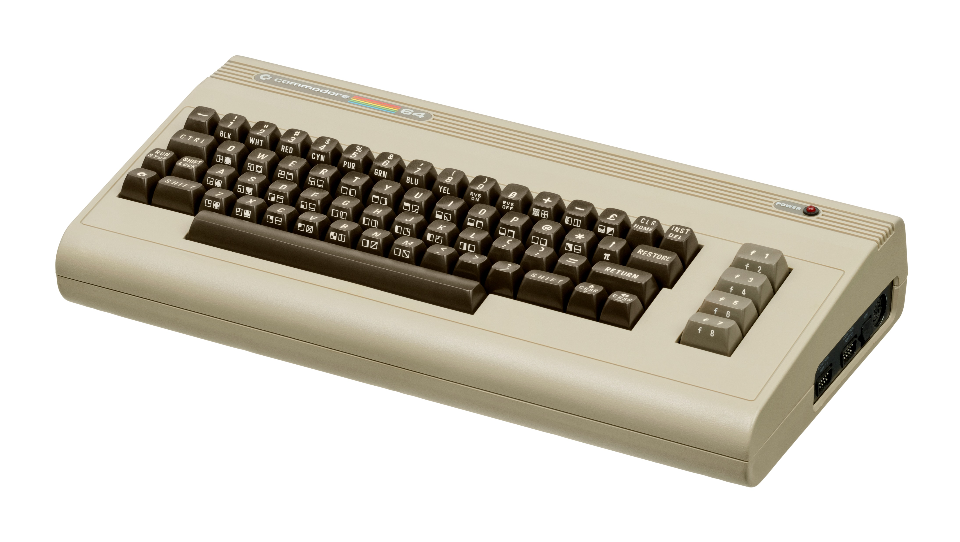
MICRO COMPUTER
. A microcomputer is a small, relatively inexpensive computer having a central processing unit (CPU) made out of a microprocessor.^{[2]} The computer also includes memory and input/output (I/O) circuitry together mounted on a printed circuit board (PCB).^{[3]} Microcomputers became popular in the 1970s and 1980s with the advent of increasingly powerful microprocessors.

Slide 12
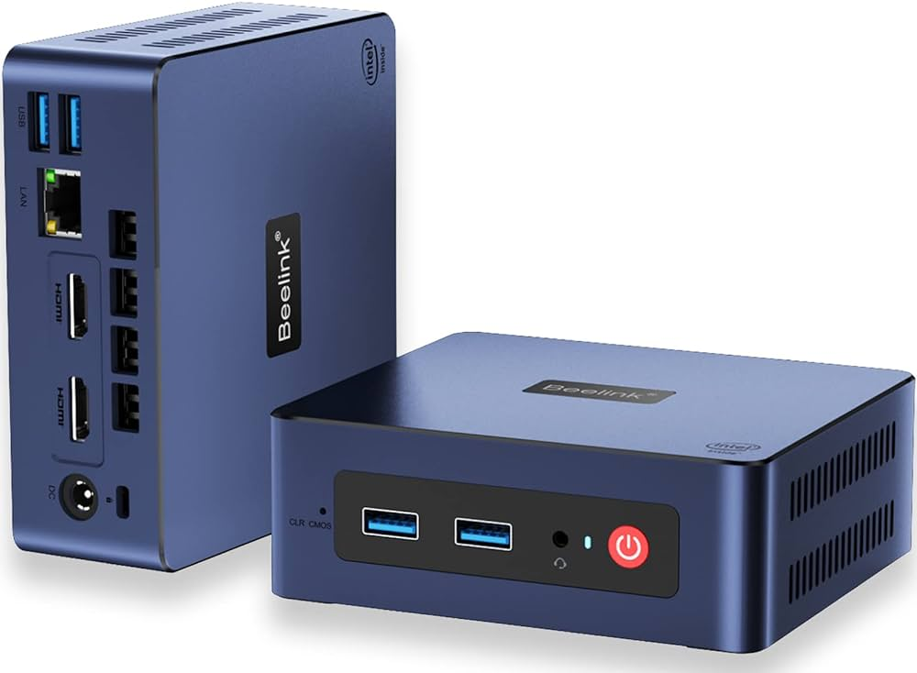
MINI COMPUTER
A minicomputer, or colloquially mini, is a type of smaller general-purpose computer developed in the mid-1960s^{[1][2]} and sold at a much lower price than mainframe^{[3]} and mid-size computers from IBM and its direct competitors. In a 1970 survey, The New York Times suggested a consensus definition of a minicomputer as a machine costing less than US$25,000 (equivalent to $196,000 in 2023^{[4]}), with an input-output device such as a teleprinter

Slide 13
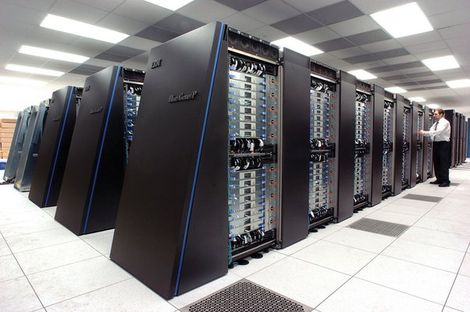
MAINFRAME COMPUTER
At their core, mainframes are high-performance computers with large amounts of memory and data processors that process billions of simple calculations and transactions in real-time. A mainframe computer is critical to commercial databases, transaction servers and applications that require high resiliency, security and agility.
Since the advent of the internet and the rise of cloud computing, some may think of the mainframe as a tech dinosaur. On the contrary, the mainframe evolved to keep pace with other technologies and continues to play a vital role in IT infrastructure.

Slide 14
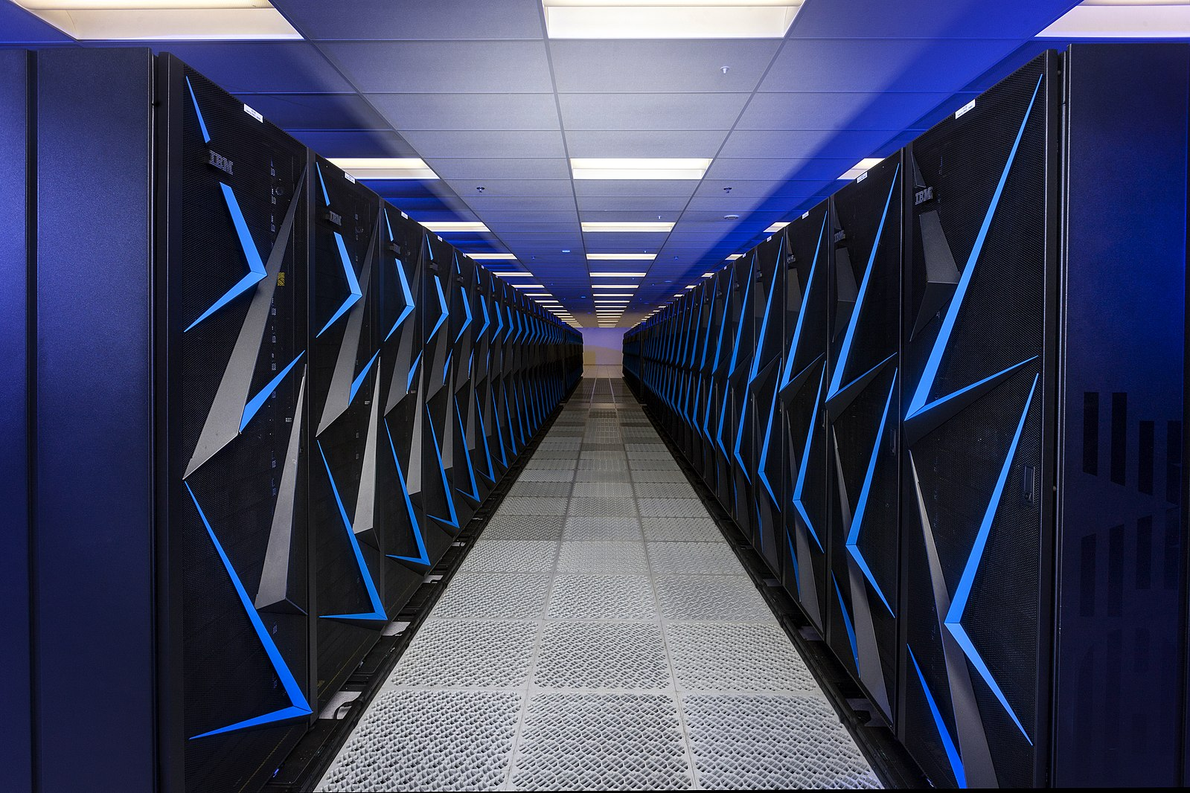
SUPER COMPUTER
A supercomputer is a type of computer with a high level of performance as compared to a general-purpose computer. The performance of a supercomputer is commonly measured in floating-point operations per second (FLOPS) instead of million instructions per second (MIPS).

Slide 15
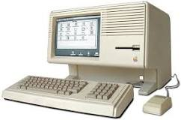
DIGITAL COMPUTER
Digital computer, any of a class of devices capable of solving problems by processing information in discrete form. It operates on data, including magnitudes, letters, and symbols, that are expressed in binary code—i.e., using only the two digits 0 and 1. By counting, comparing, and manipulating these digits or their combinations according to a set of instructions held in its memory, a digital computer can perform such tasks as to control industrial processes and regulate the operations of machines

Slide 16
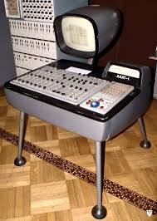
ANALOG COMPUTER
An analog computer or analogue computer is a type of computer that uses the continuous variation aspect of physical phenomena such as electrical, mechanical, or hydraulic quantities (analog signals) to model the problem being solved. In contrast, digital computers represent varying quantities symbolically and by discrete values of both time and amplitude (digital signals).
Analog computers can have a very wide range of complexity. Slide rules and nomograms are the simplest, while naval gunfire control computers and large hybrid digital/analog computers were among the most complicated.^{[1]} Complex mechanisms for process control and protective relays used analog computation to perform control and protective functions.

Slide 17
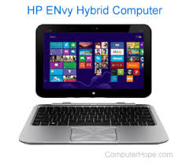
HYBRID COMPUTER
Hybrid computer is a computer intended to provide functions and features in both analog and digital computers. Developing a combined or hybrid computer model aims to produce a functional device that incorporates the most beneficial aspects of both computer systems.

Slide 18


